Slide 1
Ace Digital
Technical Assessment Q2
FFB Yield Study

Slide 2
FFB Yield Study
The purpose of this study is study how external factor affecting FFB Yield.
The dataset consist of FFB Yield (Target Variable) and other external factor (independent variable) such as average temperature.
It consist more than 10 years of FFB yield monthly observation from January of 2018 to October of 2018.

Slide 3
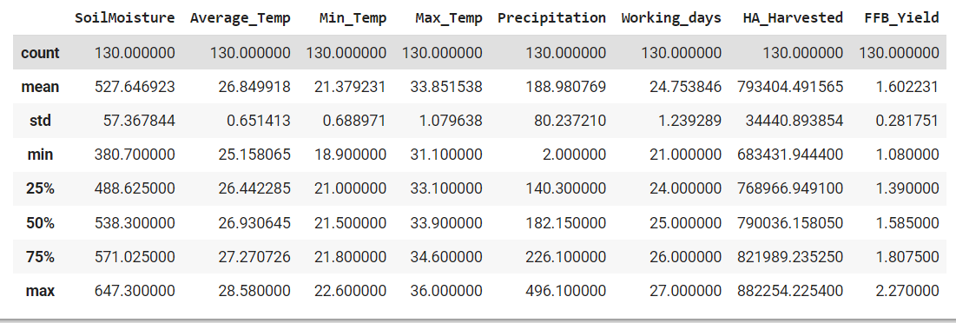
Exploratory Analysis
The dataset has total 130 observation, with no missing data. The FFB yield range from 1.08 to 2.27 in the during the period of Jan 2018 to October 2018.
All features available in the dataset are continuous variable, no categorical variable is in the dataset.
Some of the important feature is not available in the dataset, such as age of tree in the estate and amount of fertilizer used.

Slide 4
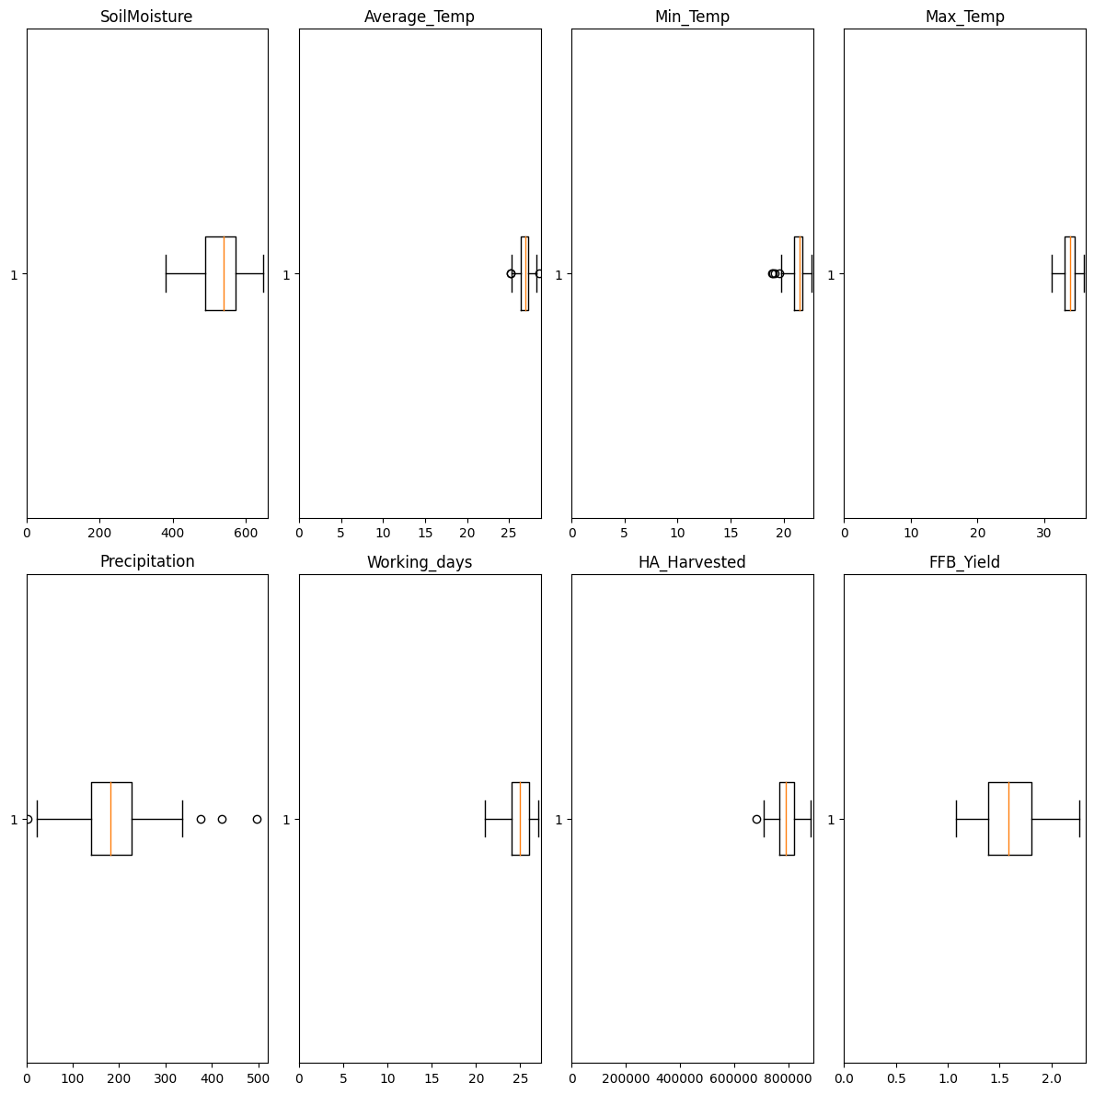
Distribution of Features
Based on box plots for all features and FFB Yield on the left. Most of the features does not fluctuate a lot like FFB Yield.
Except for Precipitation.

Slide 5
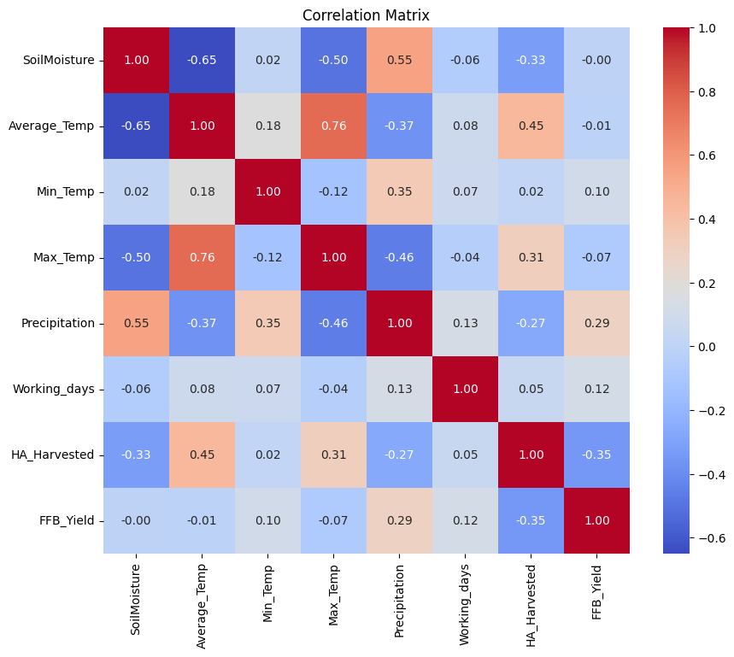
Correlation Matrix
By plotting a correlation matrix, we can notice weather related features has very weak correlation with FFB Yield such as Soil Moisture, Average Temp etc.
Precipitation is the only weather related feature that has a moderate correlation with FFB Yield.
HA Harvested has moderate negative correlation with FFB Yield.

Slide 6
Feature Engineering
In fact, most of the weather related factor from several months ago will affect FFB yield.
In order to take into account of previous 6 month weather effect, 6 month moving average has been applied to below features and created new moving average feature:
SoilMoisture
Average_Temp
Precipitation
Max_Temp
Min_Temp
Besides, the ratio of Max_Temp and Min_Temp feature is also created and applied 6 month moving average to this features too.
These features will be named as the original feature name but added _ma into the feature name. Example: 6 month moving average for Average_Temp will be named as Average_Temp_ma

Slide 7
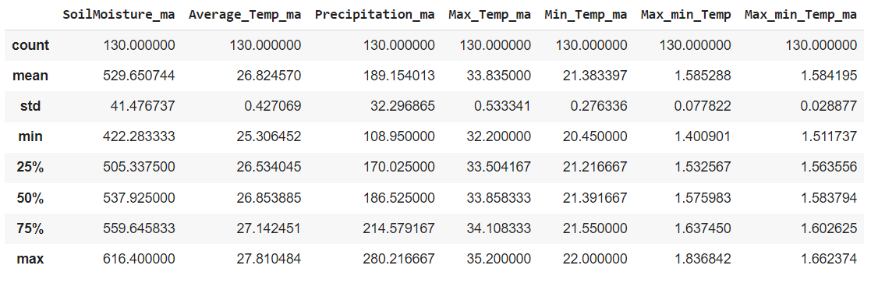
Stats Data For New Feature

Slide 8
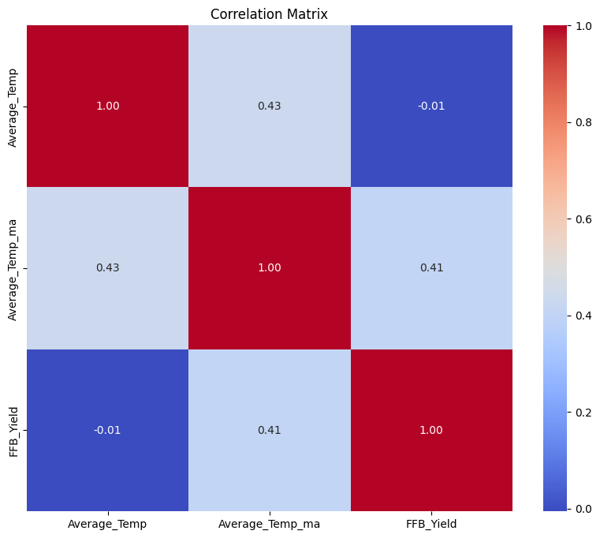
Effect of the Feature Engineering (1)
A 6 month moving average temperature has much stronger correlation compare to the average temperature of the month.
Correlation of Average_Temp is -0.01
Correlation Average_Temp_ma is 0.41.
It is a significant increase in correlation.

Slide 9
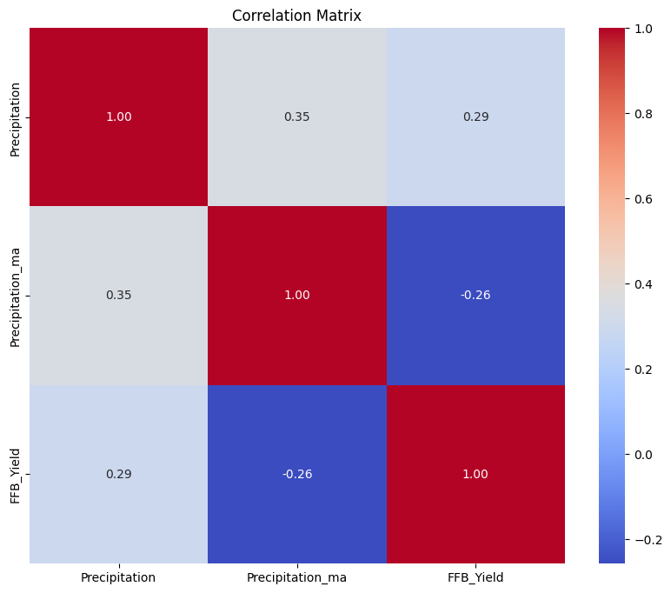
Effect of the Feature Engineering (2)
A 6 month moving average of Precipitation has total opposite effect compare to Precipitation of the month
Correlation of Precipitation is 0.29
Correlation Average_Temp_ma is -0.26.
The 6 month moving average of Precipitation has become negative correlate with FFB Yield.

Slide 10

Regression with Pycaret Library
Pycaret is the primary python library used in this study to build and train machine learning model.
PyCaret is an open source, low-code machine learning library in Python that allows user to go from preparing data to deploying machine learning model.

Slide 11
Data Preprocessing Setup in Pycaret (1)
Normalize features
Features might be recorded in different scale; those features will be required to be normalized.
Remove Multicollinearity
Multicollinearity increases the variance of the coefficients, thus making them unstable and noisy for linear models.
Remove Outlier
Outliers can distort the interpretation of the relationships between the independent variables and the dependent variable.
Feature Selection
Applied sklearn SelectFromModel to avoid overfitting and curse of dimensionality.
Only 8 features is being selected as the final predictor, namely SoilMoisture, Average_Temp, Precipitation, HA_Harvested, Average_Temp_ma, Precipitation_ma, Min_Temp_ma, Max_min_Temp_ma
Train Test Split
75% of the dataset will be used as training set while the rest used as test set.

Slide 12
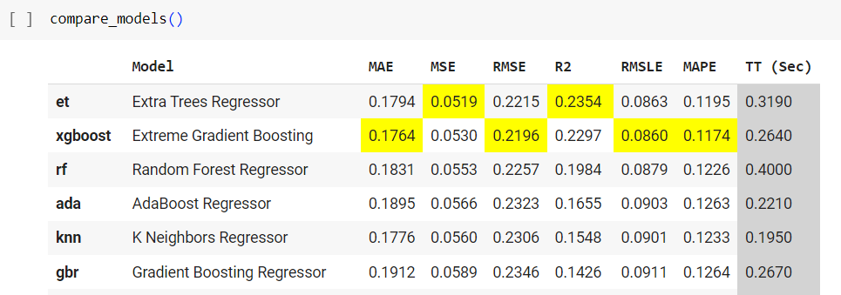
Base Model Performance Comparison
XGBoost Regressor is almost better than every base model in every metrics. It has the lowest MAE, RMSE and MAPE compared to all other model. So it has been chosen as the primary base model for further hyperparameter tuning.

Slide 13
Hyperparameter Tuning
The learning_rate control the speed of learning for each tree.
A higher learning rate allows each tree to have a larger influence on the final prediction, but having risk of overfitting if not accompanied by appropriate regularization techniques.
Max_depth, subsample and colsample help XGBOOST to control the risk of overfitting.
param_grid = {
'learning_rate': [0.1, 0.01, 0.001],
'n_estimators': [100, 200, 300],
'max_depth': [3, 4, 5],
'subsample': [0.7, 0.8, 0.9],
'colsample_bytree': [0.7, 0.8, 0.9],
}

Slide 14
Performance of Tuned Model
XGBOOST performance has improve in every metric after tuning of the model.
There is no significant performance gap between Tuned XGBOOST on train and test dataset, suggesting there is no overfitting and underfitting issue.
Metric | Base XGBOOST - Train set | Tuned XGBOOST - Train set | Tuned XGBOOST - Test set
MAE | 0.1764 | 0.1635 | 0.1537
RMSE | 0.2196 | 0.2097 | 0.2371
R2 | 0.2297 | 0.3762 | 0.4496
MAPE | 0.1174 | 0.1062 | 0.1013

Slide 15
Feature Importance
Feature | Feature Importance
HA_Harvested | 0.275
Average_Temp_ma | 0.211
Precipitation | 0.143
Min_Temp_ma | 0.115
Average_Temp | 0.087
Precipitation_ma | 0.679
Max_min_Temp_ma | 0.053
SoilMoisture | 0.048

Slide 16
Model Interpretation with SHAP
Tree-based regressors, unlike Linear Regression, are more challenging to interpret. However, we can overcome this limitation by leveraging external libraries such as SHAP, which aids in the interpretation of the model.
SHAP (SHapley Additive exPlanations) is a framework for interpreting machine learning models. It explains the contribution of each feature to the final prediction.
SHAP values are based on game theory concepts, specifically the Shapley value.
It helps answer questions like "Why did the model make this prediction?" and "Which features have the most impact?"
It provides both global and local explanations to aids in model interpretation, validation, and building trust in machine learning models.

Slide 17
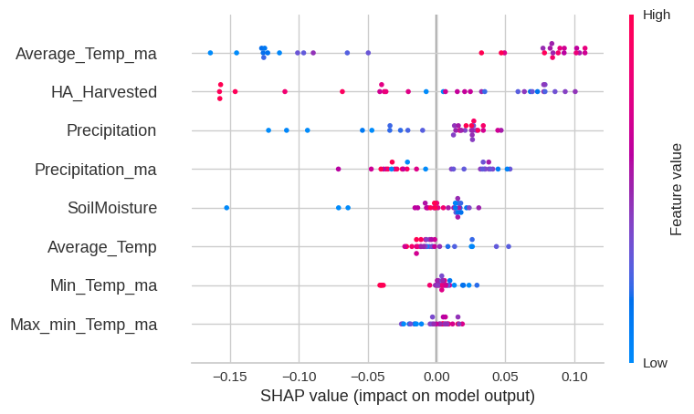
Global Explanation - Summary Plot (1)

Slide 18
Global Explanation - Summary Plot (2)
The SHAP summary plot is generated with the X Test dataset and Prediction of FFB Yield.
It visually presents feature importance based on SHAP values, with longer bars indicating higher impact and warmer colors (closer to red) indicating higher feature values. It helps in understanding the relative contributions of features to the model's predictions.

Slide 19
Findings with Summary Plot
Some findings based on summary plot:
6 month moving average of Average Temperature has strong positive correlation with FFB Yield
In contrast, Average Temperature of the current month has a moderate negative correlation with FFB Yield.
HA Harvested has strong negative correlation with FFB Yield.
Precipitation of the current month has strong positive correlation with FFB Yield.
In contrast, 6 month moving average of Precipitation has strong negative correlation with FFB Yield.
The 6 month moving average of the ratio of Max Min Temp has weak positive correlation with the FFB Yield.

Slide 20
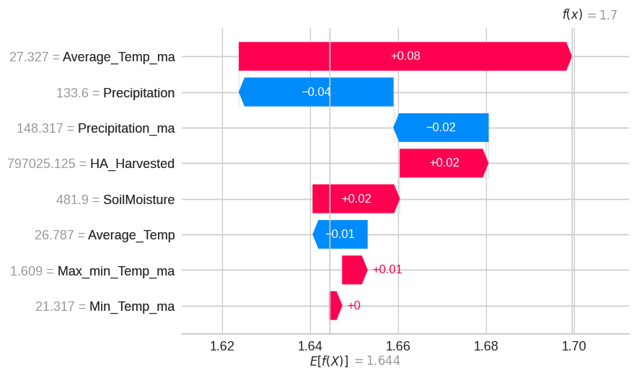
Local Explanation - Waterfall Plot (1)
Date: August 2013.
The base value of the value of the model start at 1.644.
The Moving Average of the Average Temp is at the higher end as it has exceed 75 Percentile of the Average Temp at 27.14.
So it contribute to a lot of positive value to the base value.
However, the Precipitation of 133.6 is lower than the 25 Percentile. So it also contribute high negative value to the base value.
Other features contribute some small positive and negative value to the based value. At the end, the model predict the FFB Yield is 1.7

Slide 21
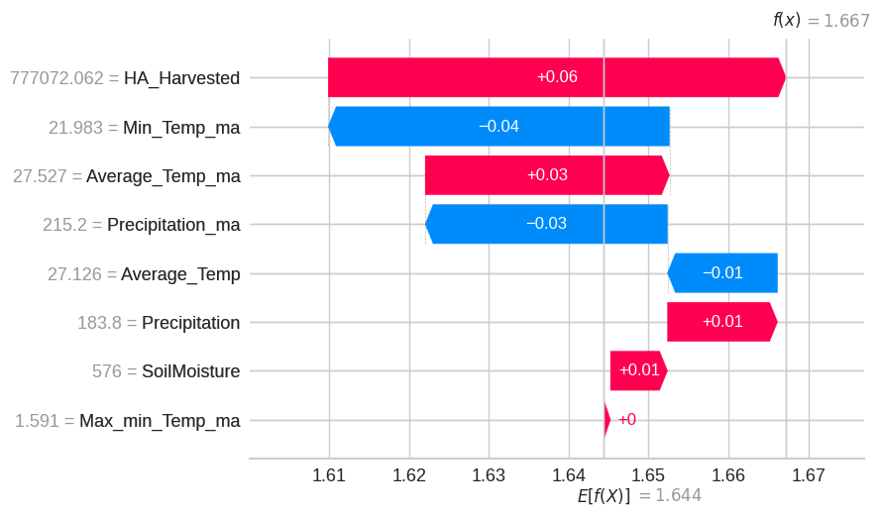
Local Explanation - Waterfall Plot (2)
Date: August 2010.
The base value of the value of the model start at 1.644.
The HA Harvested of this month is lower than the mean and median. So it contribute to a lot of positive value to the base value.
However, the Moving Average of Min Temp is 21.98 is higher than the 75 Percentile of Min Temp. So it also contribute high negative value to the bases value.
Other features contribute some small positive and negative value to the based value. At the end, the model predict the FFB Yield is 1.667

Slide 22
Summary
Weather related features are highly correlated with FFB Yield. However, we should not only take current month weather data as predictor.
Instead, we need to get the effect of the weather from the past few month to correctly predict the FFB Yield.

